Slide 1


Pipeline and Parallel Proccessing
Peyman Pahlevani

Slide 2
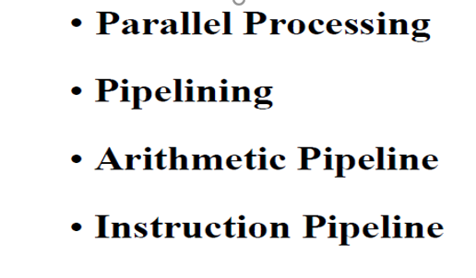
Pipeline

Slide 3
Parallel Processing
Execution of Concurrent Events in the computing process to achieve faster Computational Speed
The purpose of parallel processing is to speed up the computer processing capability and increase its throughput, that is, the amount of processing that can be accomplished during a given interval of time.
The amount of hardware increases with parallel processing, and with it, the cost of the system increases.
However, technological developments have reduced hardware costs to the point where parallel processing techniques are economically feasible.

Slide 4
Parallel processing according to levels of complexity
At the lower level
Serial Shift register VS parallel load registers
At the higher level
Multiplicity of functional units that performer identical or different operations simultaneously.

Slide 5
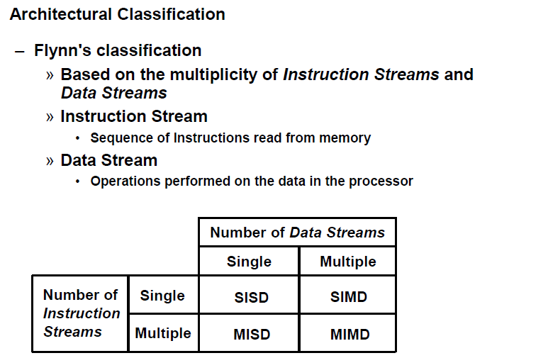
Parallel Computers

Slide 6
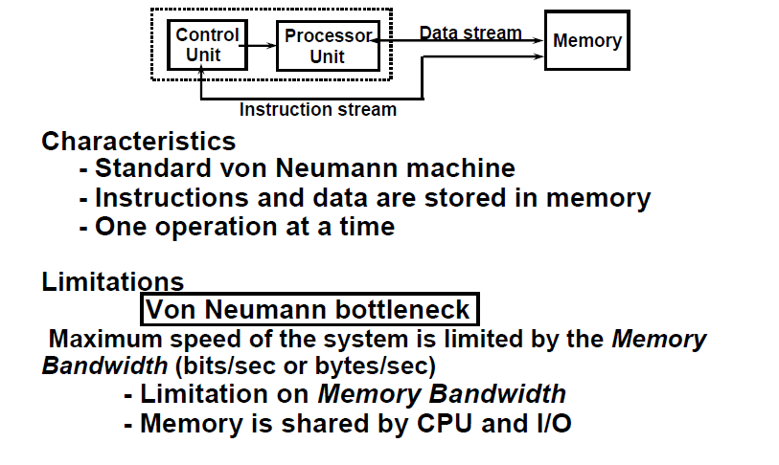
SISD COMPUTER SYSTEMS

Slide 7
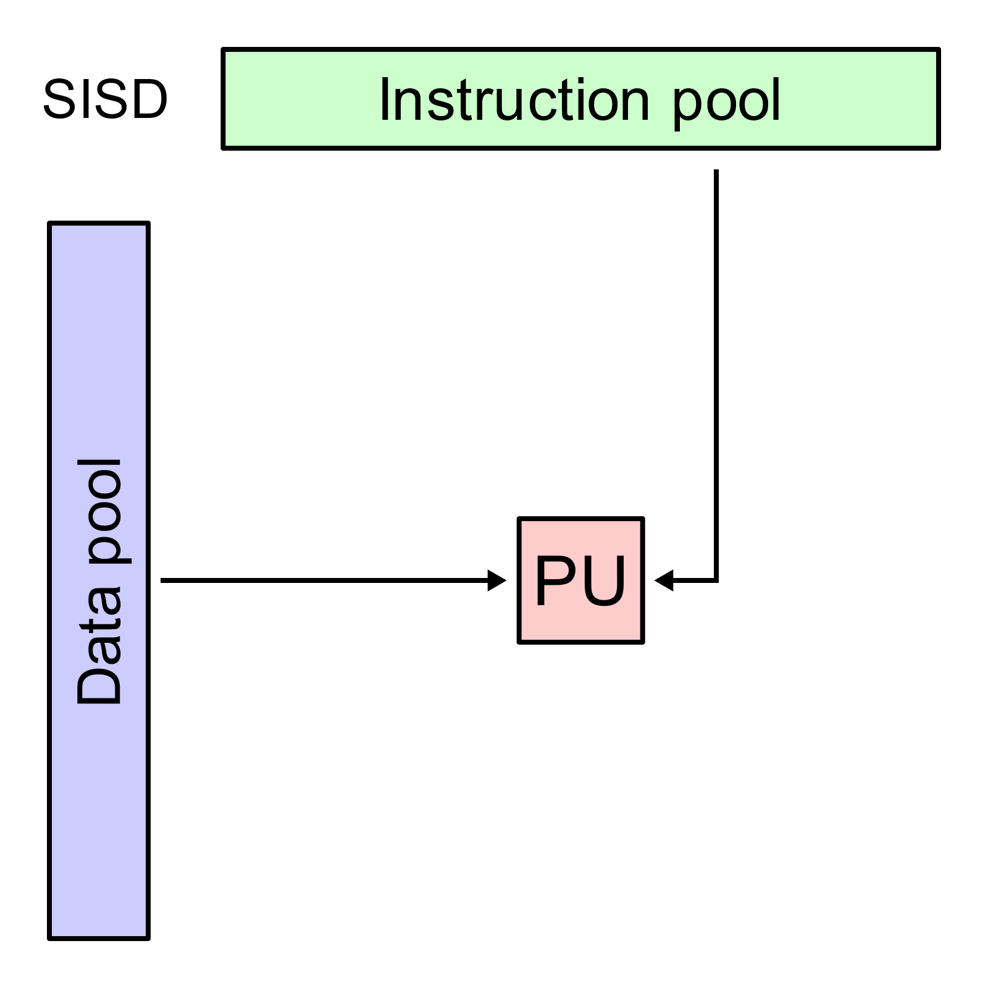

Slide 8
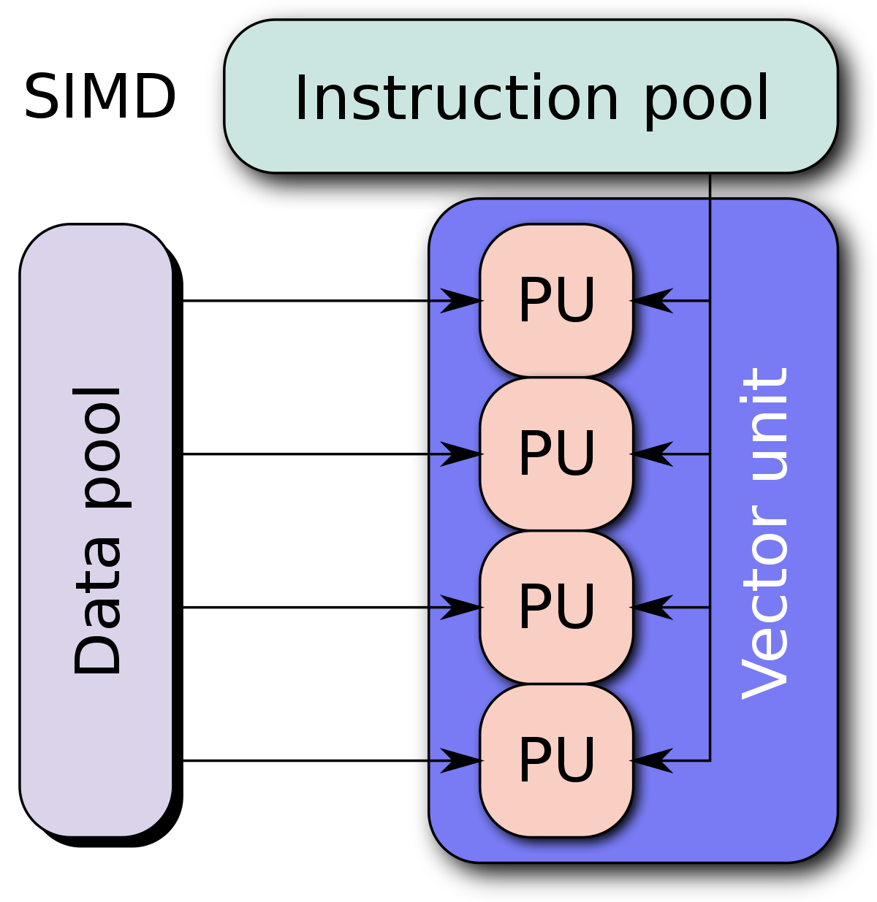

Slide 9
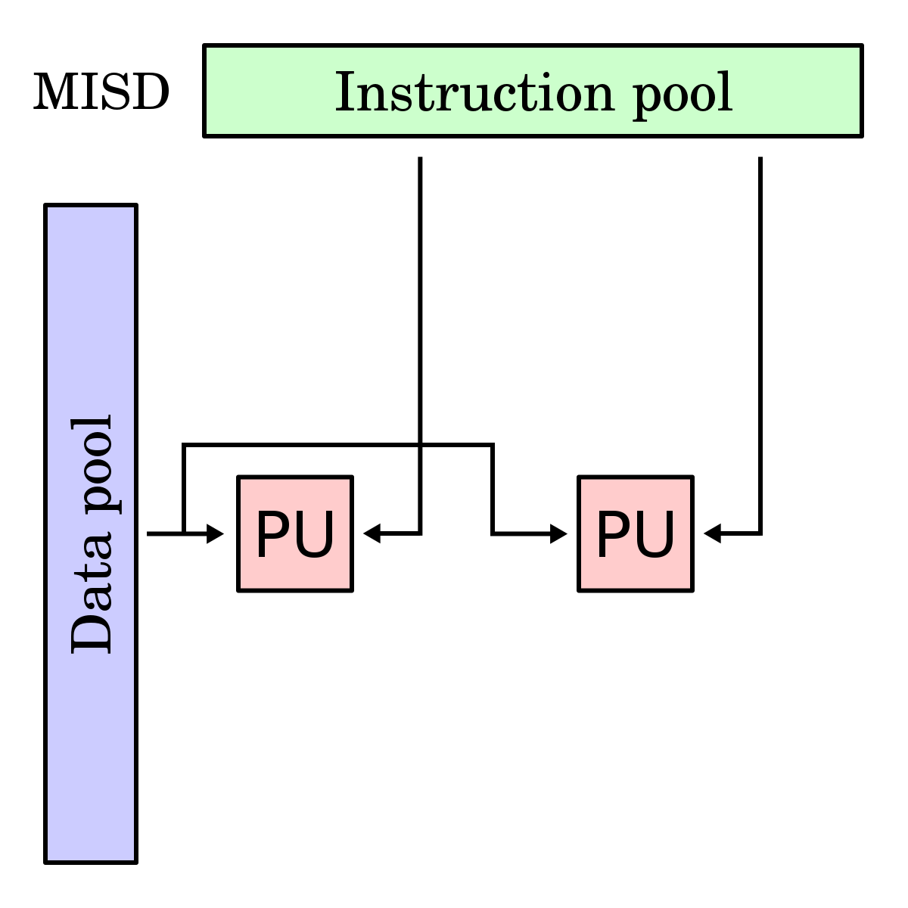

Slide 10
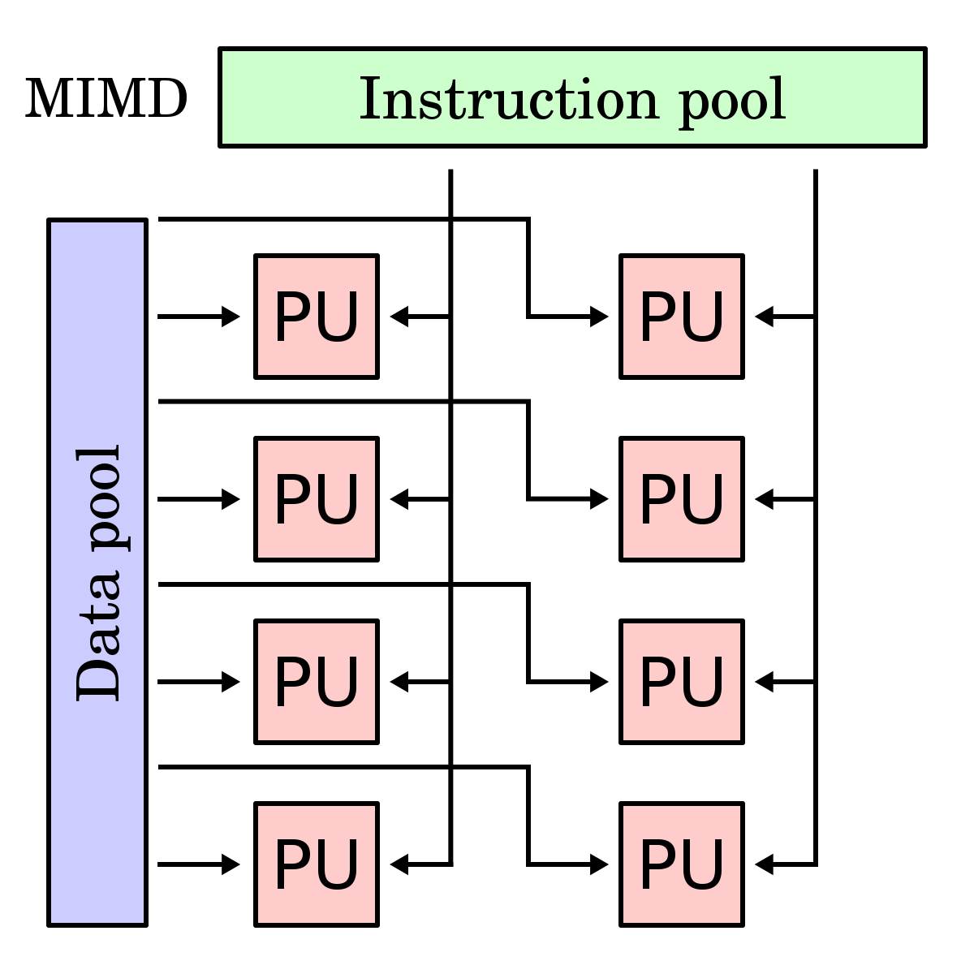

Slide 11
PIPELINING
A technique of decomposing a sequential process into suboperations, with each subprocess being executed in a partial dedicated segment that operates concurrently
with all other segments.
A pipeline can be visualized as a collection of processing segments through which binary information flows.
The name “pipeline” implies a flow of information analogous to an industrial assembly line.

Slide 12
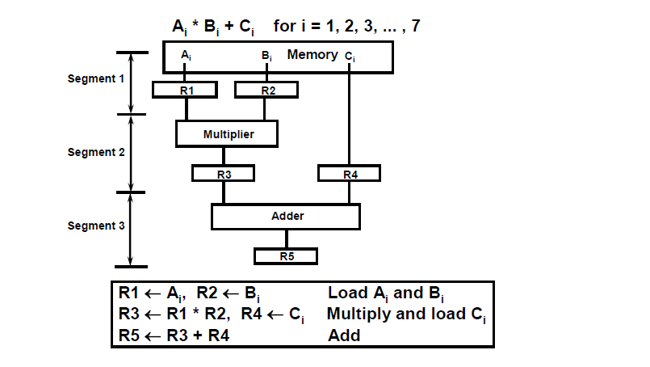
Example of the Pipeline Organization

Slide 13
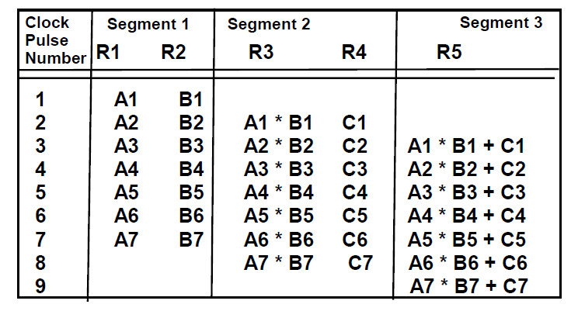
OPERATIONS IN EACH PIPELINE STAGE

Slide 14
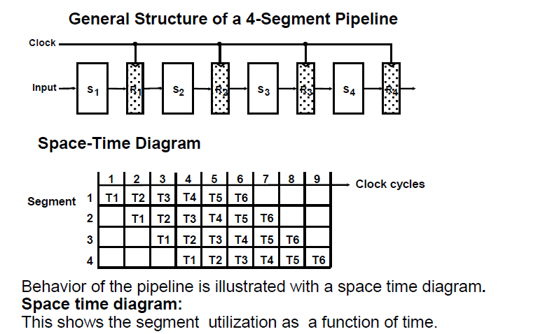
GENERAL PIPELINE

Slide 15
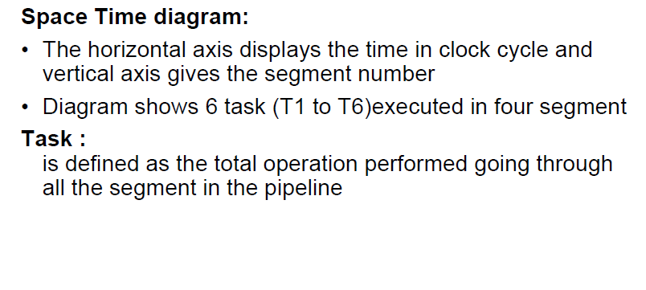
Cont.

Slide 16
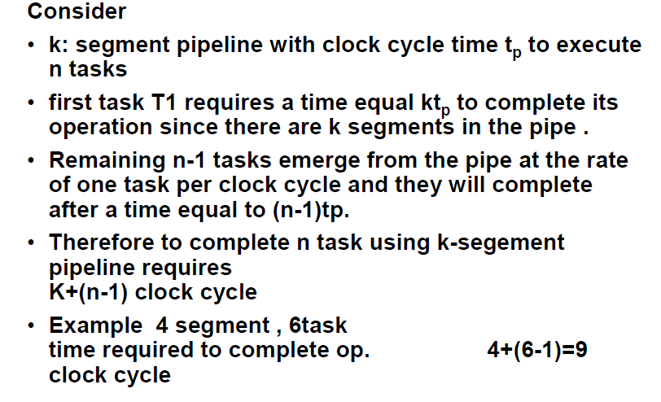
Speedup ratio of pipeline

Slide 17
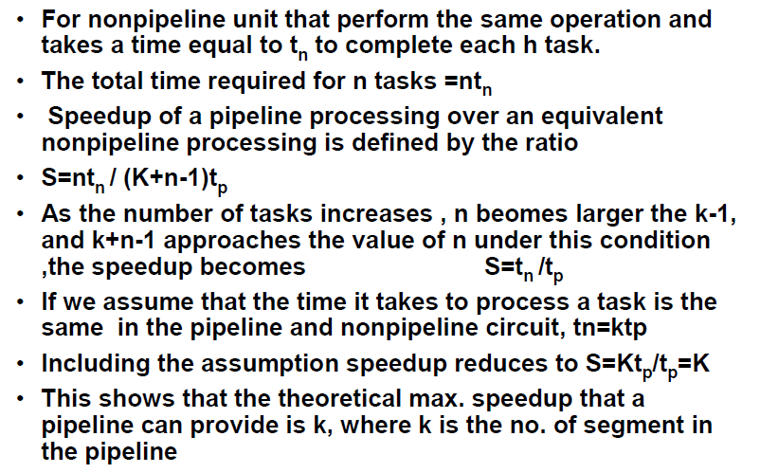
Cont.

Slide 18
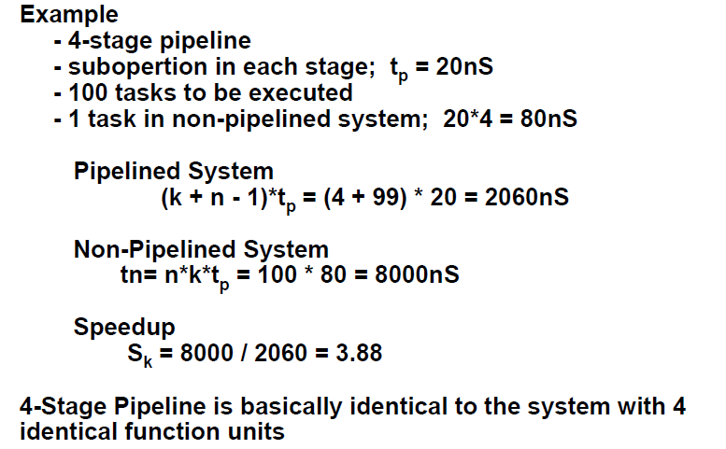
PIPELINE AND MULTIPLE FUNCTION UNITS

Slide 19
Pipeline speedup
However, this only happens if the pipeline stages are all of equal length.
Splitting a 40 ns operation into 5 stages, each 8 ns long, will result in a 5x speedup.
Splitting the same operation into 5 stages, 4 of which are 7.5 ns long and one of which is 10 ns long will result in only a 4x speedup.

Slide 20
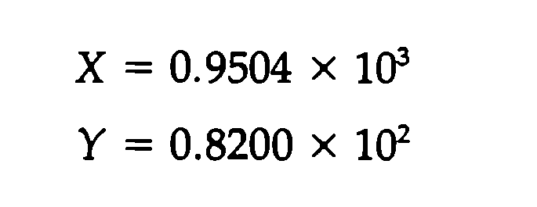
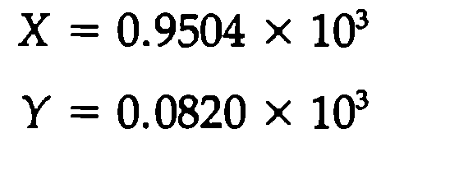
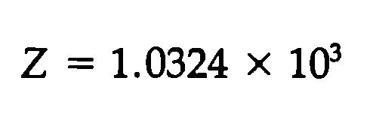
Floating point addition
Two normal input
Mantis alignment
Addition result
Normalization result

Slide 21
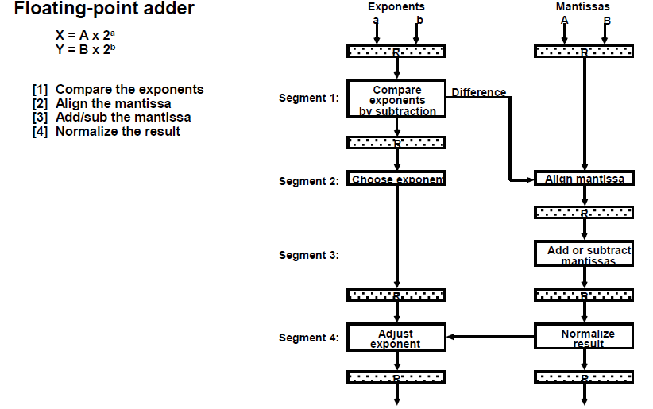
ARITHMETIC PIPELINE

Slide 22
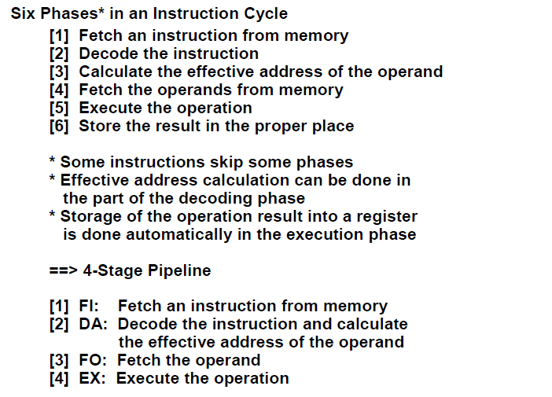
INSTRUCTION CYCLE

Slide 23
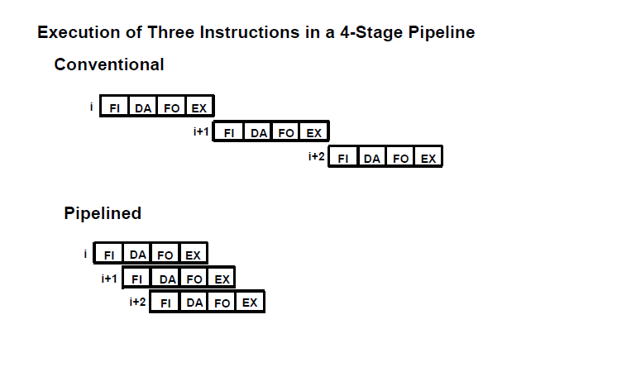
INSTRUCTION PIPELINE

Slide 24
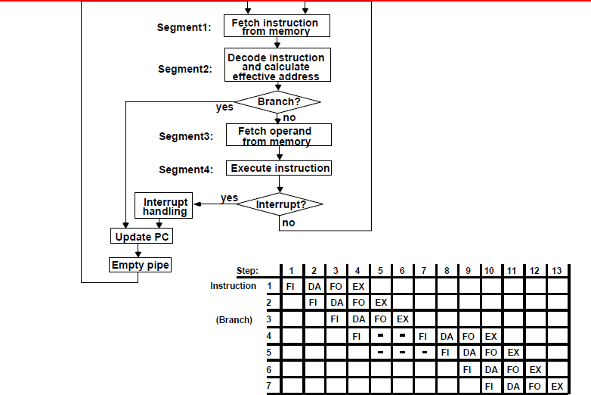
INSTRUCTION EXECUTION IN A 4-STAGE PIPELINE

Slide 25
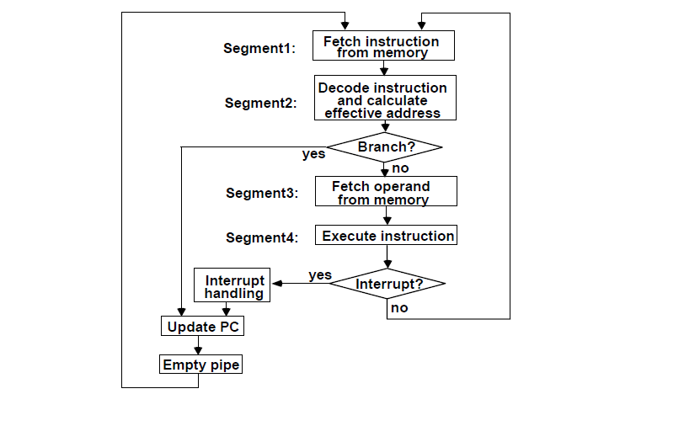
Pipeline

Slide 26
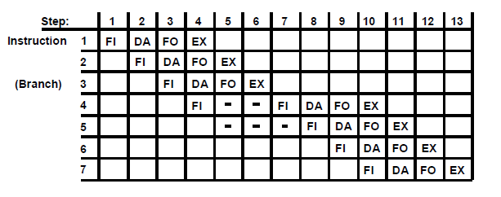
Space time diagram

Slide 27
MAJOR HAZARDS IN PIPELINED EXECUTION
Structural hazards (Resource Conflicts):
Hardware resources required by the instructions
simultaneous overlapped execution cannot be met.
Data hazards (Data Dependency Conflicts):
An instruction scheduled to be executed in the
pipeline requires the result of a previous instruction,
which is not yet available.
Control hazards (Branch difficulties):
Branches and other instructions that change the PC
make the fetch of the next instruction to be delayed.

Slide 28
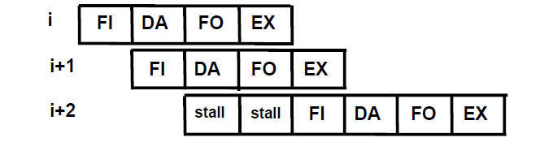
STRUCTURAL HAZARDS
Occur when some resource has not been duplicated enough to allow all combinations of instructions in the pipeline to execute.
Example:
With one memory-port, a data and an instruction fetch cannot be initiated in the same clock.
The Pipeline is stalled for a structural hazard
<- Two Loads with one port memory
-> Two-port memory will serve without stall

Slide 29
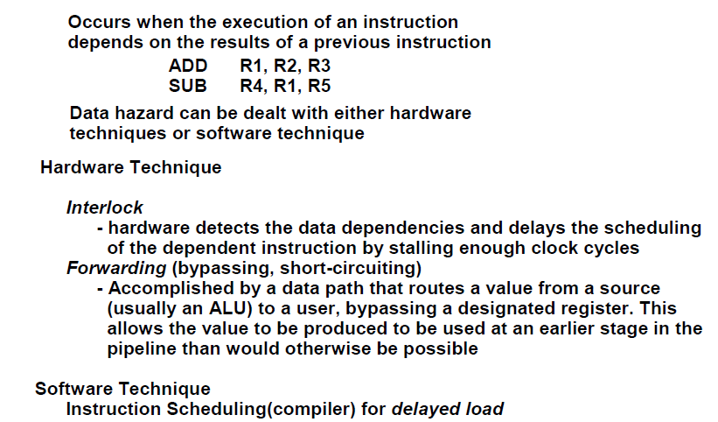
DATA HAZARDS

Slide 30
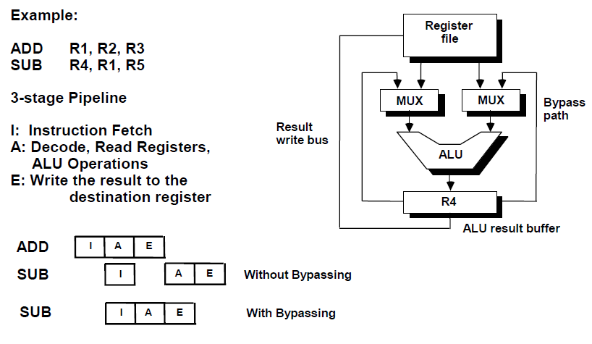
FORWARDING HARDWARE

Slide 31
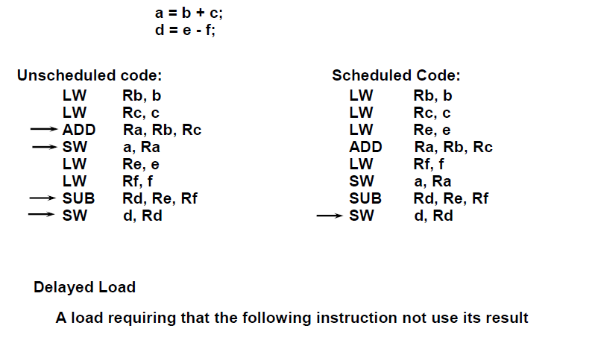
INSTRUCTION SCHEDULING

Slide 32
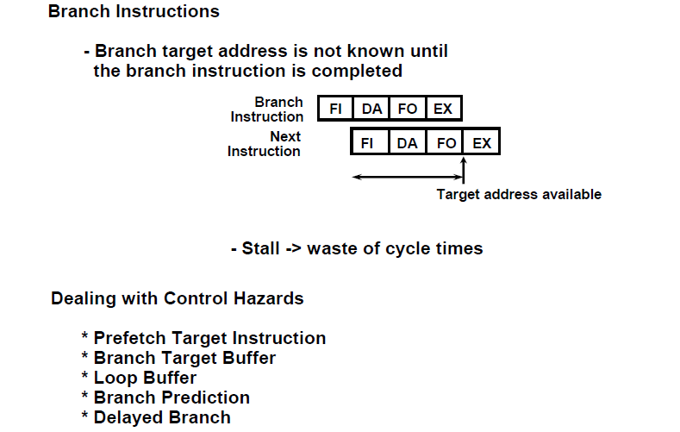
CONTROL HAZARDS

Slide 33
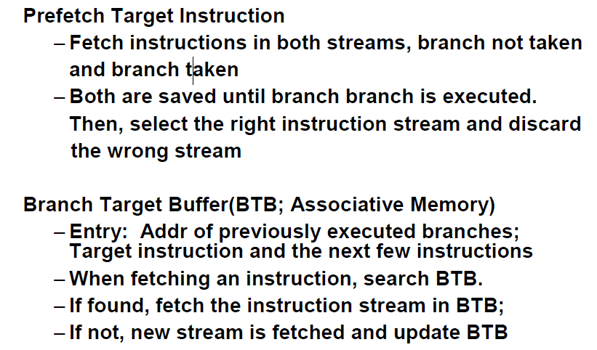
CONTROL HAZARDS

Slide 34
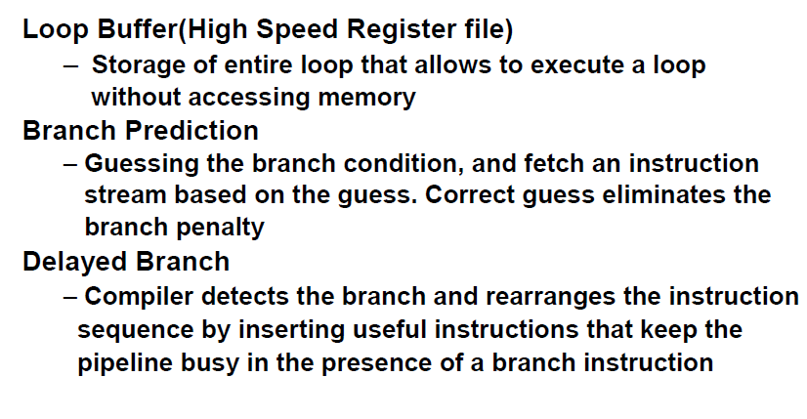
CONTROL HAZARDS

Slide 35
Exercise
9.1, 9.2, 9.3, 9.4,9.5, 9.7
9.11, 9.12, 9.13,

